Slide 1


DAMPING EFFECT DUE TO PERFORATION IN THE SHIM IN JOURNAL BEARING
Submitted in partial fulfillment for award of degree
BACHELOR OF ENGINEERING
In
MECHANICAL ENGINEERING
SUBMITTED BY:
R Rajesh Kumar 1BM15ME124
Raju S 1BM15ME132
Sanjay K 1BM15ME145
Under the guidance of
Dr. G. SARAVANAKUMAR
Assistant Professor
Department of Mechanical Engineering
(Accredited by NBA, under Tier 1, 2014-2019)
B.M.S COLLEGE OF ENGINEERING
(Autonomous Institution Affiliated to Visvesvaraya Technological University, Belgaum)

Slide 2
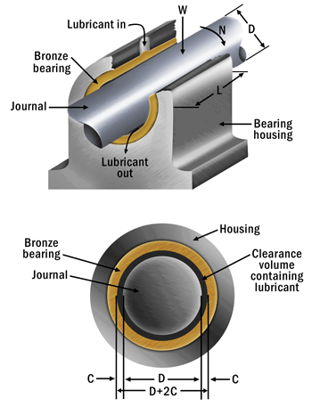
Journal Bearing
Machine element which supports the load in radial direction
Why is it preferred
High load and velocities
Long durablity
Smooth running

Slide 3
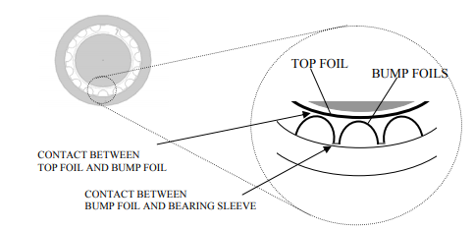
Journal Bearing with Bumps(Compliant)
Top foil
Bumps acts as spring providing stiffness
These entire things pushes the bearing
preventing shaft contact
By placing bumps ,the frictional forces
provides damping characteristics
Bumps suppress instabilities and vibration

Slide 4
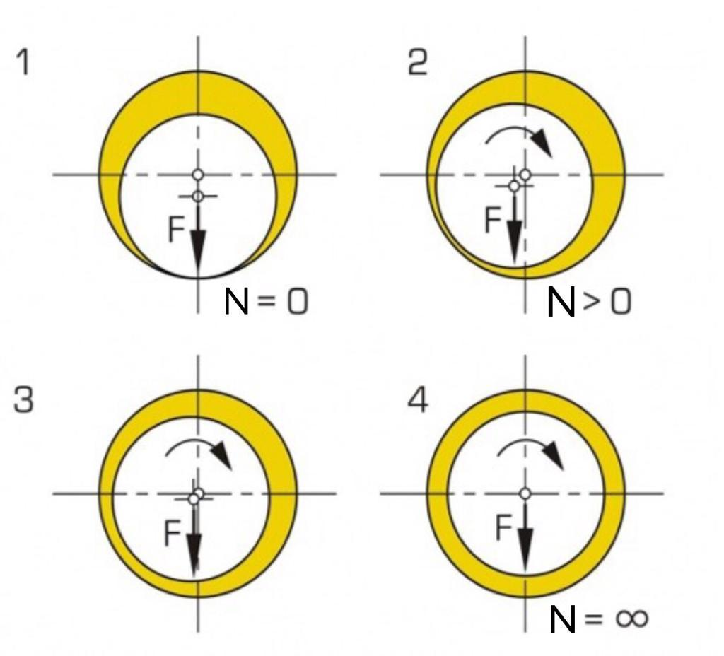
Literature Review
Learnt basics from Lubrication principles and bearings theoretical principles
and design by E.I RADZIMOVSKY, professor at University of Illinois.
Mechanism of continuous film formation
in bearing-Juliana Javorova1Bulgaria Sofia
An exact analytical solution of the Reynolds equation for the finite
journal bearing lubrication D. Sfyris, A. Chasalevris.
In infinitely short (narrow) hydrodynamic journal bearings,
the length of bearing in axial direction is very short.
Normalized Reynolds equation ,Prof. Harish Hirani , IIT , Delhi

Slide 5
By Oscar De Santiago, Luis San Andres
STATIC AND DYNAMIC CHARACTERIZATION OF A BUMP-TYPE BEARING -BY SÉBASTIEN LE LEZ
The goal of this paper is to improve the understanding of the behaviour of the bump type bearing structure under static and dynamic loads.
The area of investigation is that this type of bearing has only a limited dynamic stiffness which when combined with the minimum film thickness provides with a load capacity of a few Newton.

Slide 6
Problem Statement
Controlling the vibrations in shaft and bearing system.
Increase the damping effect and finally results in the effective control of vibration.
Preventing damage to machines due to fatigue
Noise reduction
By placing bumps ,the frictional forces provides damping characteristics

Slide 7
Methadology
Deriving the Steady state Reynolds equation for converging film(supports Load carrying capacity).
Normalising the variables in the Reynolds equation(x , z , p and h).
Applying Finite Difference Method.
Placing the bumps.
Obtaining its numerical solution by Mat-lab codes.
Comparing the energy dissipation with and without bumps.

Slide 8
Converging film
Derive Reynolds Equation
With bumps
Without bumps
Convert into polar co-ordinates
Normalize and get reduced equation
Normalize and get reduced equation
Apply FDM
Apply FDM
Final Equation
Final Equation
Matlab code
Matlab-code

Slide 9
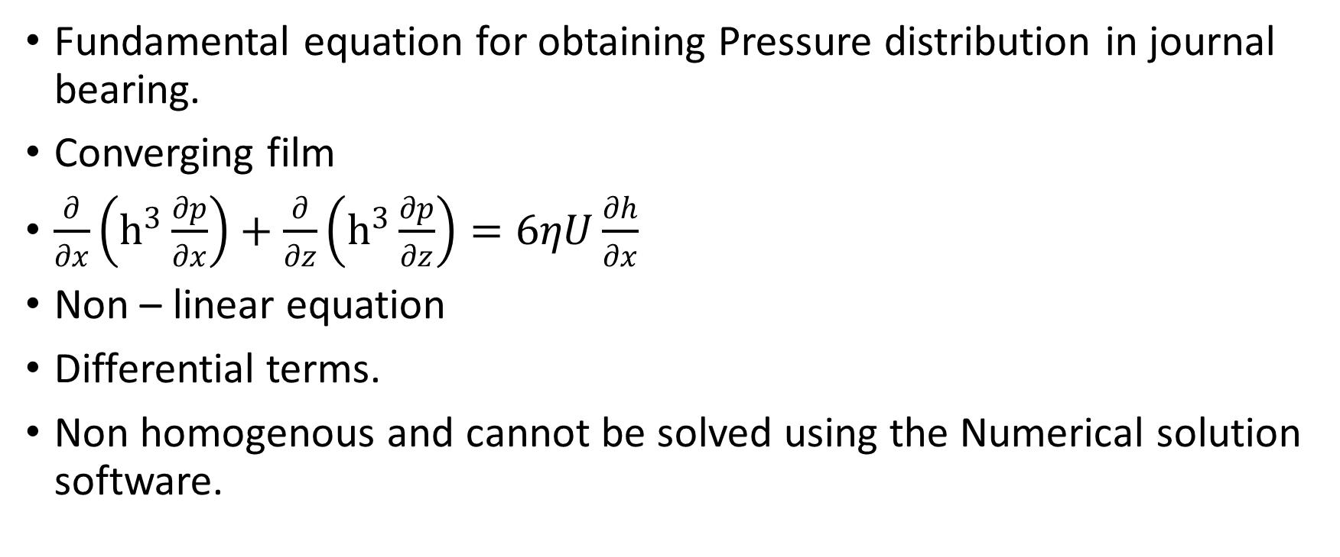
Reynolds equation
Fundamental equation for obtaining Pressure distribution in journal bearing.
Converging film
$\frac{∂}{∂x}\left(h^{3}\frac{∂p}{∂x}\right)+\frac{∂}{∂z}\left(h^{3}\frac{∂p}{∂z}\right)=6ηU\frac{∂h}{∂x}$
Non – linear equation
Differential terms.
Non homogenous and cannot be solved using the Numerical solution software.

Slide 10
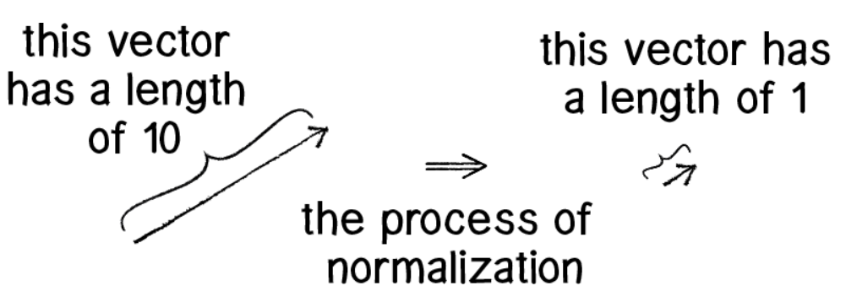
Normalisation
Normalisation is a process of making the variable to range in (0,1)
Example:-

Slide 11
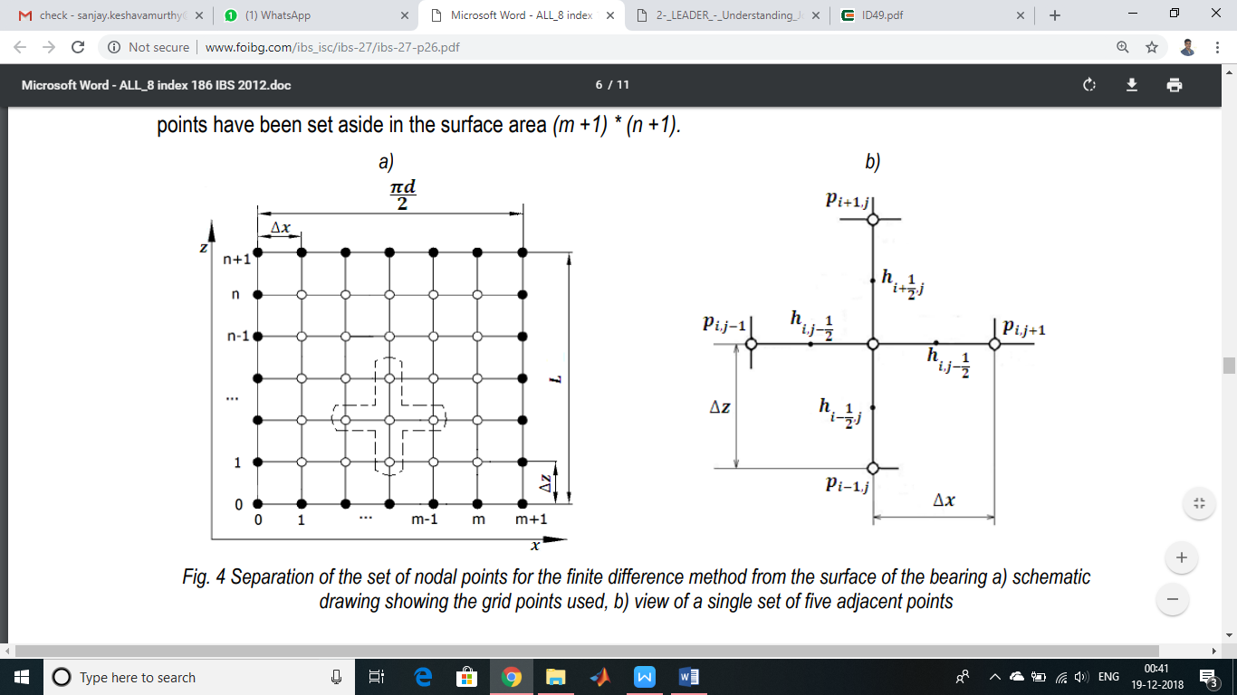
Finite difference method
Numerical methods for solving differential equation by approximating them with difference equation in which finite differences approximates the derivatives.
FDM is used to replace the derivatives of the governing equation with algebraic difference quotients
Here Δx & Δz is assumed to be constant
Discretized points called as nodes (grids)

Slide 12
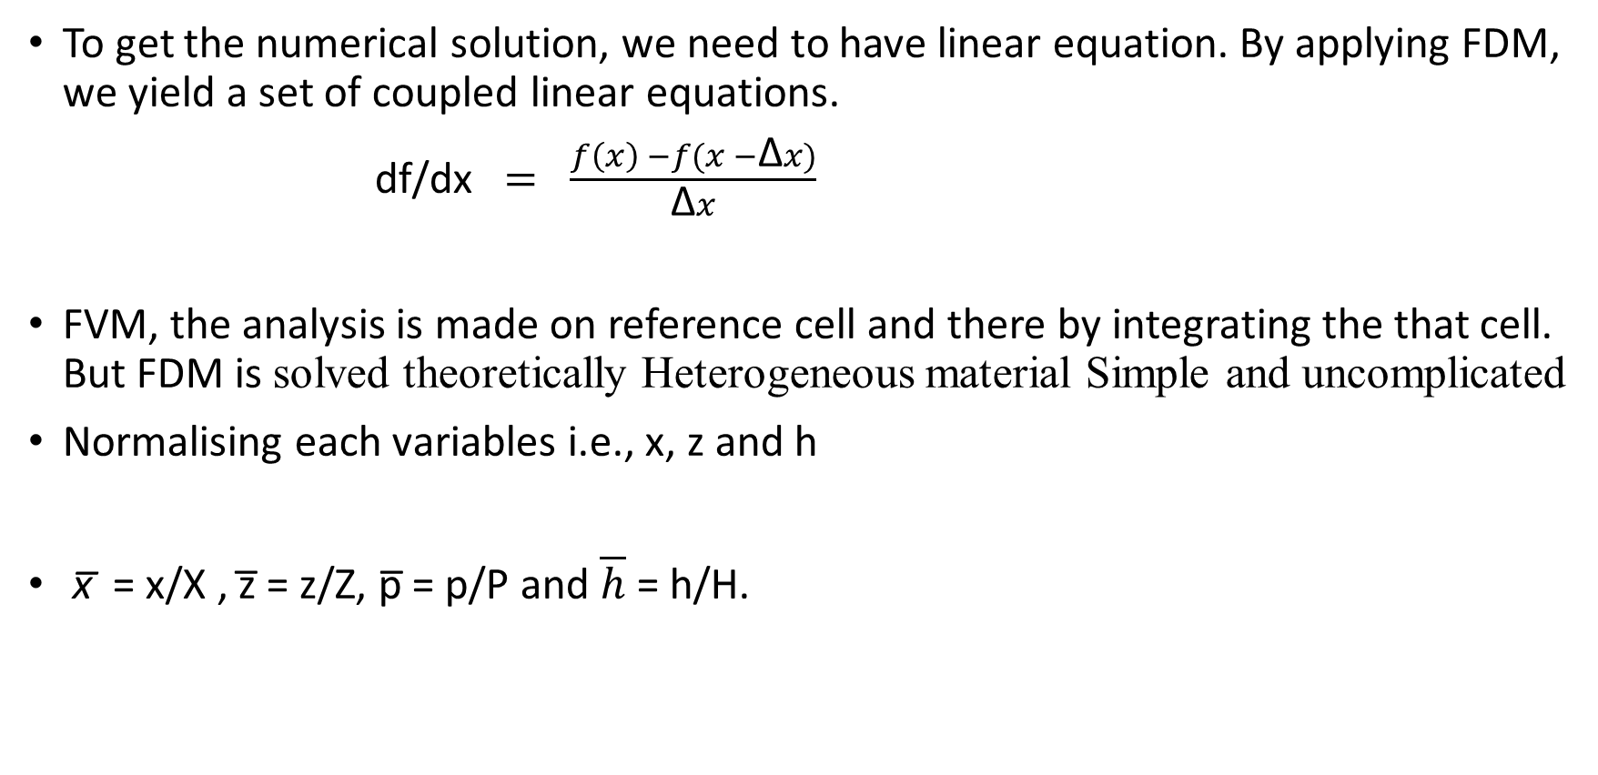
Why FDM
To get the numerical solution, we need to have linear equation. By applying FDM, we yield a set of coupled linear equations.
df/dx $= \frac{f\left(x\right) −f(x −\text{Δ}x)}{\text{Δ}x}$
FVM, the analysis is made on reference cell and there by integrating the that cell. But FDM is solved theoretically Heterogeneous material Simple and uncomplicated
Normalising each variables i.e., x, z and h
x̅ = x/X , z̅ = z/Z, p̅ = p/P and $\overline{h}$= h/H.

Slide 13
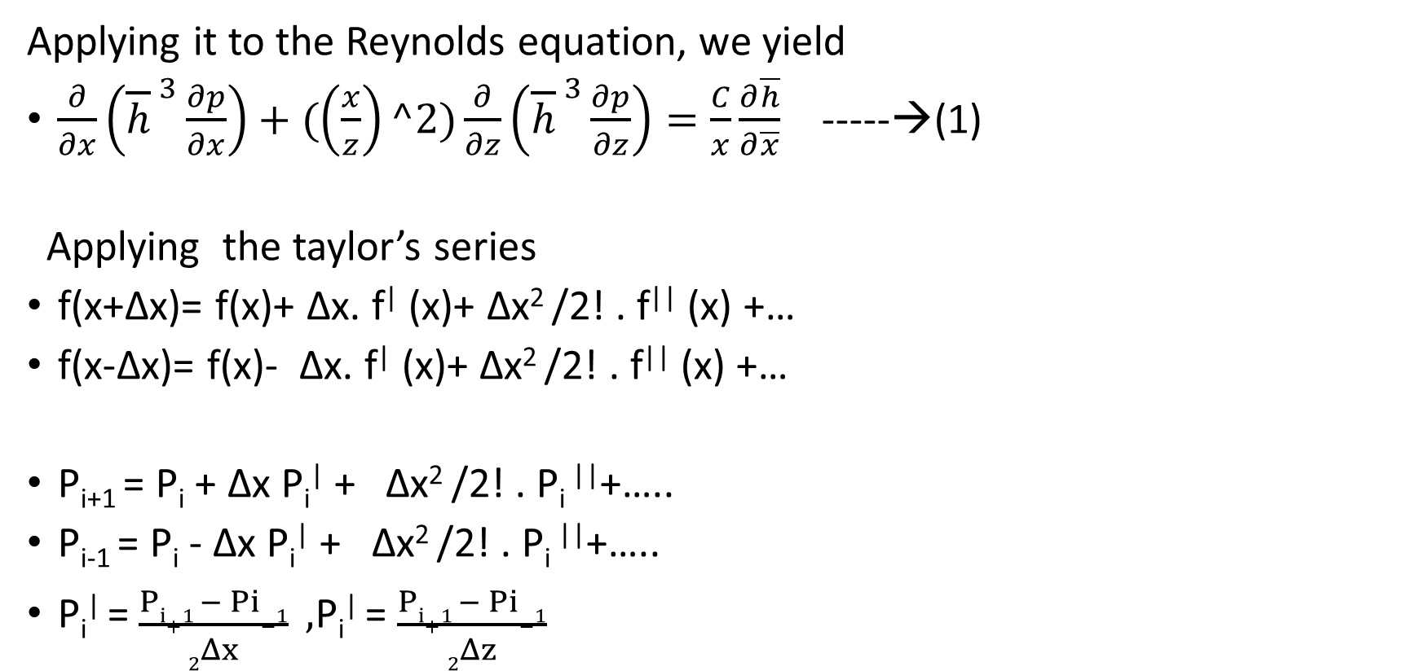
Applying FDM
Applying it to the Reynolds equation, we yield
$\frac{∂}{∂x}\left({\overline{h}}^{ 3}\frac{∂p}{∂x}\right)+(\left(\frac{x}{z}\right)^2)\frac{∂}{∂z}\left({\overline{h}}^{ 3}\frac{∂p}{∂z}\right)=\frac{C}{x}\frac{∂\overline{h}}{∂\overline{x}}$ -----→(1)
Applying the taylor’s series
f(x+Δx)= f(x)+ Δx. f| (x)+ Δx² /2! . f|| (x) +…
f(x-Δx)= f(x)- Δx. f| (x)+ Δx² /2! . f|| (x) +…
P_{i+1} = P_{i} + Δx P_{i}| + Δx² /2! . P_{i} ||+…..
P_{i-1} = P_{i} - Δx P_{i}| + Δx² /2! . P_{i} ||+…..
P_{i}| = $\frac{Pi+1 − Pi−1}{2Δx} ,$P_{i}| = $\frac{Pi+1 − Pi−1}{2Δz}$

Slide 14

$\frac{∂}{∂x}\left({\overline{h}}^{ 3}\frac{∂p}{∂x}\right)$ →[ ${\overline{h}}^{ 3}$_{i,j+0.5} p̅³ _{i,j+1} + ${\overline{h}}^{ 3}$_{i-0.5,j} p̅ ³ _{i-1,j} - (${\overline{h}}^{ 3}$_{i+0.5,j} + ${\overline{h}}^{ 3}$_{i-0.5,j} ) . p̅ _{i,j}] / (Δx)²
$\frac{∂}{∂z}\left({\overline{h}}^{ 3}\frac{∂p}{∂z}\right)$→ [ ${\overline{h}}^{ 3}$_{i,j+0.5} .p̅³ _{i,j+1} + ${\overline{h}}^{ 3}$_{i,j-0.5} p̅ ³ _{i,j-1} - (${\overline{h}}^{ 3}$_{i,j+0.5} + ${\overline{h}}^{ 3}$_{i,j-0.5} ) . p̅ _{i,j} ] / (Δz)²
$\frac{∂\overline{h}}{∂\overline{x}} −→$ [ ${\overline{h}}^{ }$_{i+1,j} - ${\overline{h}}^{ }$_{i-1,j} ] / 2Δx
p̅ ⁰ _{i,j} = 0
On putting the above values to the equation (1),we get
p(I,J) = A* p(I,J+1) + A* p(I,J-1) + C* p(I+1,J) + D* p(I-1,J) - E;

Slide 15
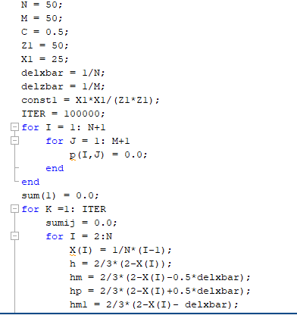
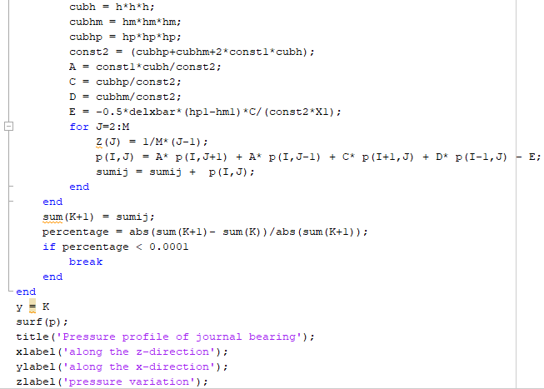
Matlab Code

Slide 16
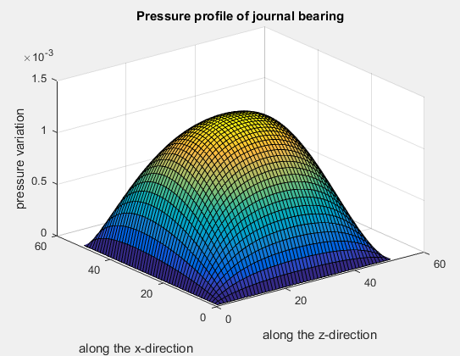
Graph obtained

Slide 17
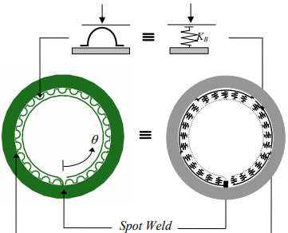
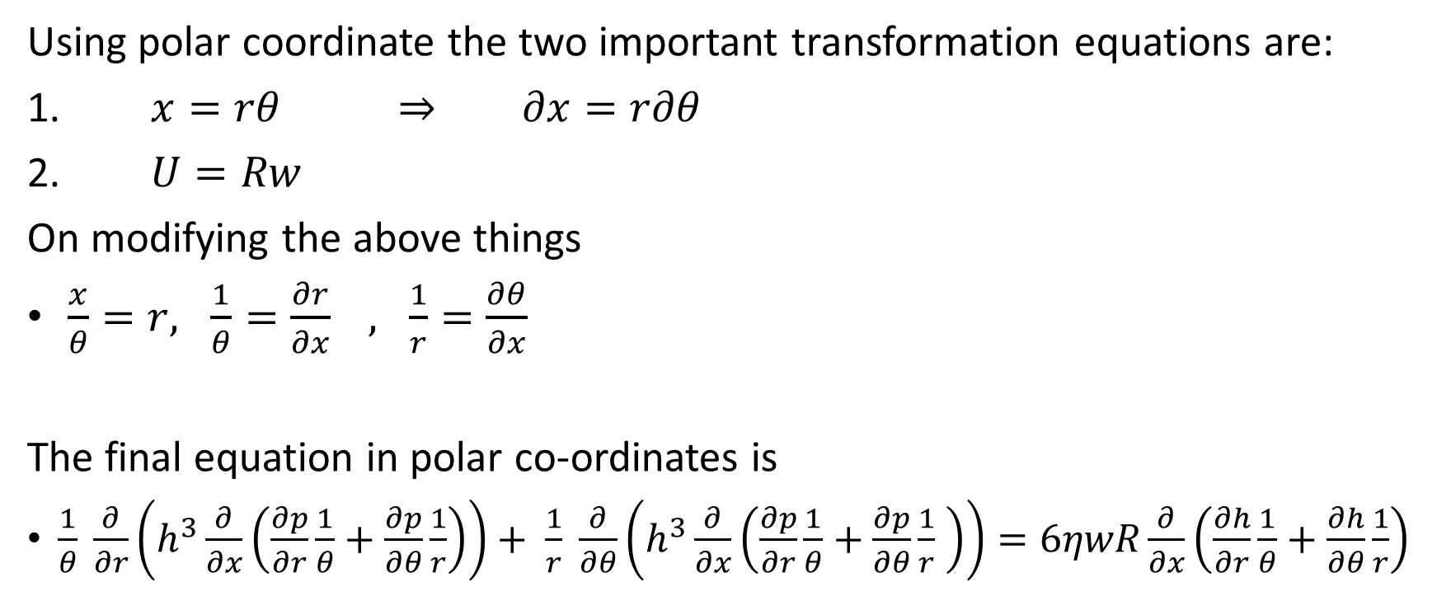
Case 2:- With Bumps
Using polar coordinate the two important transformation equations are:
1. $x=rθ$ ⇒ $∂x=r∂θ$
2. $U=Rw$
On modifying the above things
$\frac{x}{θ}=r, \frac{1}{θ}=\frac{∂r}{∂x} , \frac{1}{r}=\frac{∂θ}{∂x}$
The final equation in polar co-ordinates is
$\frac{1}{θ} \frac{∂}{∂r}\left(h^{3}\frac{∂}{∂x}\left(\frac{∂p}{∂r}\frac{1}{θ}+\frac{∂p}{∂θ}\frac{1}{r}\right)\right)+ \frac{1}{r} \frac{∂}{∂θ}\left(h^{3}\frac{∂}{∂x}\left(\frac{∂p}{∂r}\frac{1}{θ}+\frac{∂p}{∂θ}\frac{1}{r} \right)\right)=6ηwR\frac{∂}{∂x}\left(\frac{∂h}{∂r}\frac{1}{θ}+\frac{∂h}{∂θ}\frac{1}{r}\right)$

Slide 18
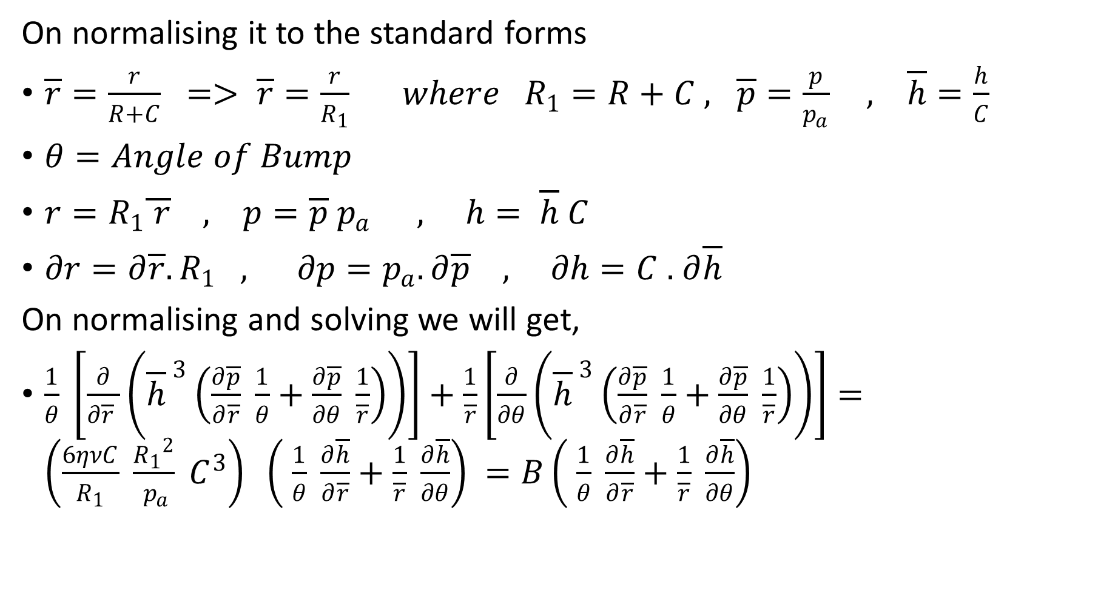
On normalising it to the standard forms
$\overline{r}=\frac{r}{R+C} => \overline{r}=\frac{r}{R_{1}} where R_{1}=R+C , \overline{p}=\frac{p}{p_{a}} , \overline{h}=\frac{h}{C}$
$θ=Angle of Bump$
$r=R_{1}\overline{ r} , p=\overline{p} p_{a }, h= \overline{h} C$
$∂r=∂\overline{r}.R_{1} , ∂p=p_{a}.∂\overline{p} , ∂h=C .$ $∂\overline{h}$
On normalising and solving we will get,
$\frac{1}{θ} \left[\frac{∂}{∂\overline{r} }\left({\overline{h}}^{ 3}\left(\frac{∂\overline{p}}{∂\overline{r}} \frac{1}{θ}+\frac{∂\overline{p}}{∂θ} \frac{1}{\overline{r}}\right)\right)\right]+\frac{1}{\overline{r}}\left[\frac{∂}{∂θ}\left({\overline{h}}^{ 3}\left(\frac{∂\overline{p}}{∂\overline{r}} \frac{1}{θ}+\frac{∂\overline{p}}{∂θ} \frac{1}{\overline{r}}\right)\right)\right]=\left(\frac{6ηνC}{R_{1}} \frac{{R_{1}}^{2}}{{ p}_{a}} C^{3}\right) \left( \frac{1}{θ} \frac{∂\overline{h}}{∂\overline{r}}+\frac{1}{\overline{r}} \frac{∂\overline{h}}{∂θ}\right)$ $=B\left( \frac{1}{θ} \frac{∂\overline{h}}{∂\overline{r}}+\frac{1}{\overline{r}} \frac{∂\overline{h}}{∂θ}\right)$

Slide 19

This is the final equation to be solved in MATLAB
$p_{i,j}=A_{i,j }{\overline{p}}_{i,j}+B_{i,j}{\overline{ p}}_{i,j+1} +C_{i,j}{\overline{ p}}_{i+1,j}+D_{i,j}{\overline{ p}}_{i−1,j}+E, Where$
$A=\frac{\left(\frac{{{\overline{h}}^{3}}_{i+0.5,j}}{θ^{2}{∆\overline{r}}^{2}}+\frac{{{\overline{h}}^{3}}_{i,j+0.5}}{∆θ\overline{ r }∆\overline{r} θ}\right)}{K}$
$B=\frac{\left(\frac{{{\overline{h}}^{3}}_{i+0.5,j}}{θ^{2}{∆\overline{r}}^{2}}+\frac{{{\overline{h}}^{3}}_{i,j+0.5}}{∆θ\overline{ r }∆\overline{r} θ}\right)}{K}$
$C=\frac{\left(\frac{{{\overline{h}}^{3}}_{i−0.5,j}}{θ^{2}{∆\overline{r}}^{2}}+\frac{{{\overline{h}}^{3}}_{i,j−0.5}}{∆θ\overline{ r }∆\overline{r} θ}\right)}{K}$
$D=\frac{\left(\frac{{{\overline{h}}^{3}}_{i−0.5,j}}{∆θ\overline{ r }∆\overline{r} θ}+\frac{{{\overline{h}}^{3}}_{i,j−0.5}}{{∆θ}^{2} {\overline{r}}^{2}}\right)}{K}$
$E=\frac{−B\left(\frac{{\overline{h}}_{i+1,j}−{\overline{h}}_{i−1,j}}{2∆\overline{r}θ}+\frac{{\overline{h}}_{i,j+1}−{\overline{h}}_{i,j−1}}{2r∆θ}\right)}{K}$

Slide 20
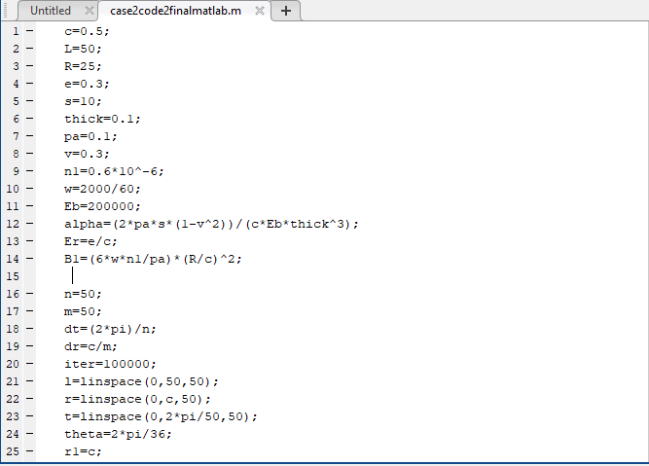
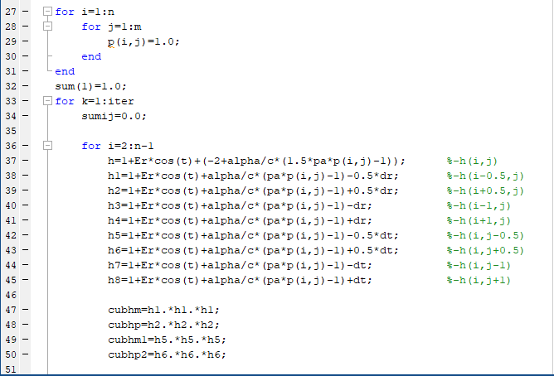
Case 2 :- With Bumps

Slide 21
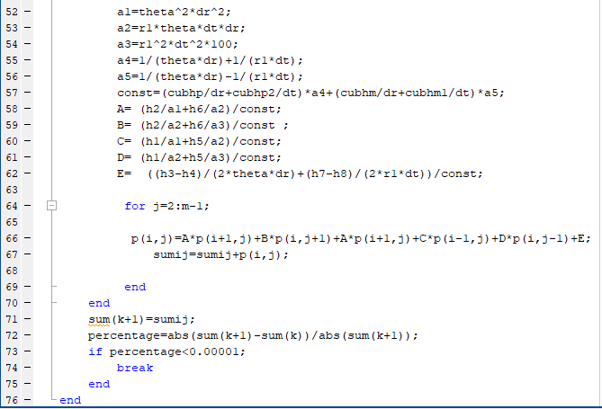
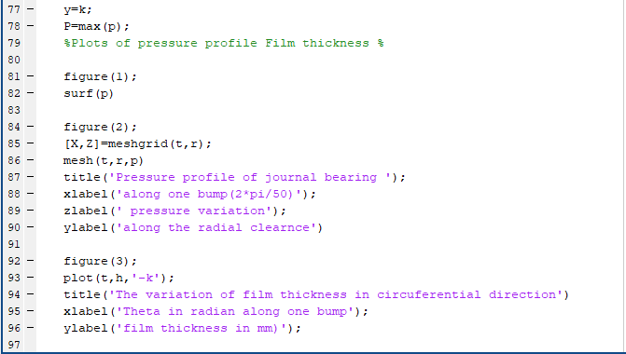
$$p_{i,j}=A_{i,j }{\overline{p}}_{i,j}+B_{i,j}{\overline{ p}}_{i,j+1} +C_{i,j}{\overline{ p}}_{i+1,j}+D_{i,j}{\overline{ p}}_{i−1,j}+E$$

Slide 22
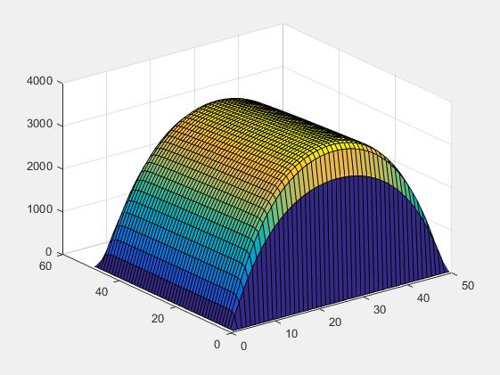
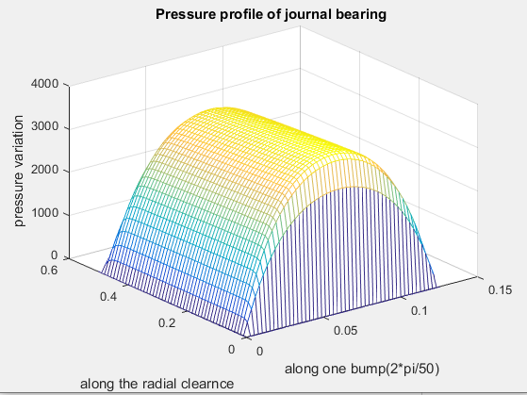

Slide 23
Comparison of results
With out Bump | With Bumps
Pressure value = 800Mpa | Pressure value = 2500Mpa
Damping is less. Hence vibrations are more. | Vibrations are controlled because of increase in damping
Energy dissipated is less | Energy dissipated is more because of higher damping by placing bumps

Slide 24
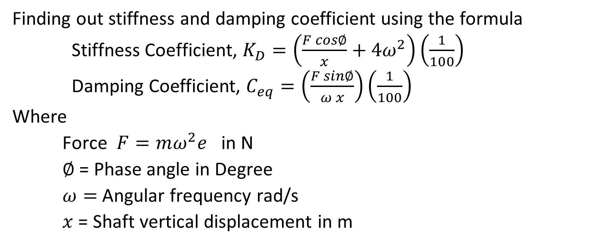
Structural parameters of Bump
Finding out stiffness and damping coefficient using the formula
Stiffness Coefficient, $K_{D}=\left(\frac{F cos∅}{x}+4ω^{2}\right)\left(\frac{1}{100}\right)$
Damping Coefficient, $C_{eq}=\left(\frac{F sin∅}{ω x}\right)\left(\frac{1}{100}\right)$
Where
Force $F=mω^{2}e$ in N
$∅$= Phase angle in Degree
$ω=$Angular frequency rad/s
$x$ = Shaft vertical displacement in m

Slide 25
Energy equations for damped 1 DOF system
The energy balance of a frictional dissipative system
E_{u} + E_{k} + E_{k} – E_{w}= C^{te}
Viscous damping, where the damping force is proportional to the velocity
mx¨ + cx˙ + kx = f(t)
Structural or hysteretic damping, where the damping force is internal to the material
mx¨ + k* x = f(t)

Slide 26
Coulomb friction damping, where the damping force is proportional to the normal load
mx¨ + kx = ft − gN sin(x)
The energy dissipated in one cycle for a system with all types of damping is
Wcycle = = kγπ X²
The motions of a structurally damped system with harmonic excitations are themselves harmonic
mx¨ + k x˙ + kx = f(t)

Slide 27
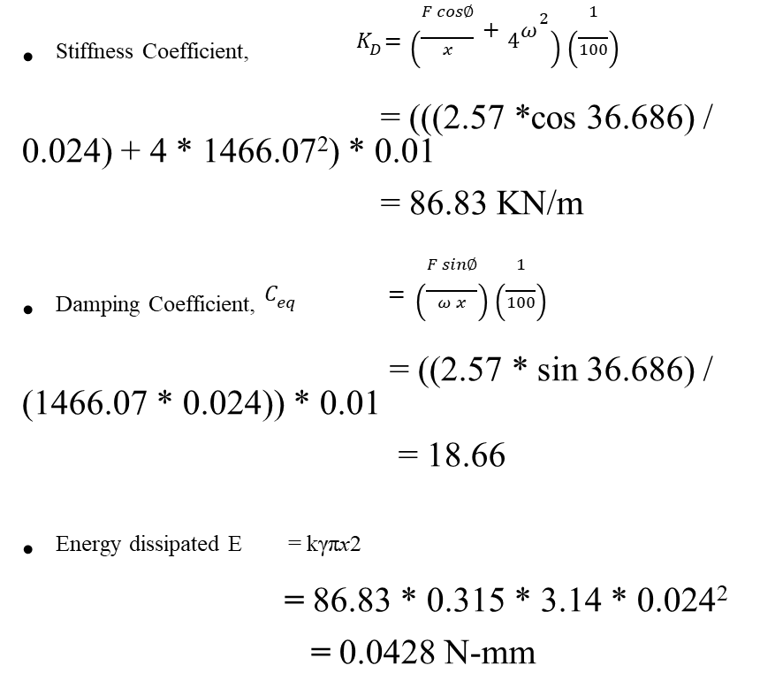

Calculation
^{Angular velocity} $ω$ ^{= 2piN/60}
= (2 * 3.14 * 14000) / 60
= 1466.07 m/sec
Excitation frequency = $ω$ ^{/2pi}
= (1466.07)/ (2 * 3.14)
= 233.45 Hz
^{Force} $F =mω^{2}e$
= 60*10⁻³ * 1466.07² * 0.02 * 10⁻³
= 2.57
^{Stiffness Coefficient,} ${ K}_{D}=\left(\frac{F cos∅}{x}+4ω^{2}\right)\left(\frac{1}{100}\right)$
= (((2.57 *cos 36.686) / 0.024) + 4 * 1466.07²) * 0.01
= 86.83 KN/m
^{Damping Coefficient,} $C_{eq} =\left(\frac{F sin∅}{ω x}\right)\left(\frac{1}{100}\right)$
= ((2.57 * sin 36.686) / (1466.07 * 0.024)) * 0.01
= 18.66
Energy dissipated E = kγπx2
= 86.83 * 0.315 * 3.14 * 0.024²
= 0.0428 N-mm

Slide 28
Calculation
Speed (N) RPM | Angular velocity (rad/ sec) | Excitation frequency (Hz) | Force (N) | Stiffness (KN/m) | Ceq | Energy dissipated (N-mm)
13000 | 1361.36 | 216 | 2.224 | 74.84 | 17.3 | 0.0428
14000 | 1466.07 | 233 | 2.57 | 86.83 | 18.66 | 0.0494
15000 | 1570.8 | 250 | 2.96 | 100 | 20 | 0.0572
16000 | 1675.5 | 266 | 3.36 | 113.41 | 21.328 | 0.0642
17000 | 1780.23 | 283 | 3.803 | 128 | 22.6 | 0.0731
18000 | 1884.9 | 300 | 4.26 | 143.5 | 24 | 0.081
19000 | 1989.6 | 316 | 4.75 | 159.9 | 25.3 | 0.091
20000 | 2099.4 | 333 | 5.26 | 177.21 | 26.6 | 0.113

Slide 29
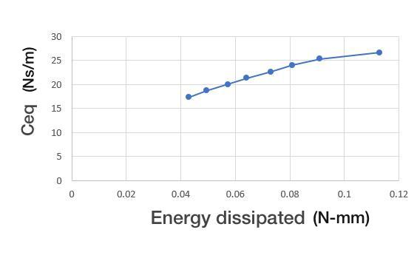
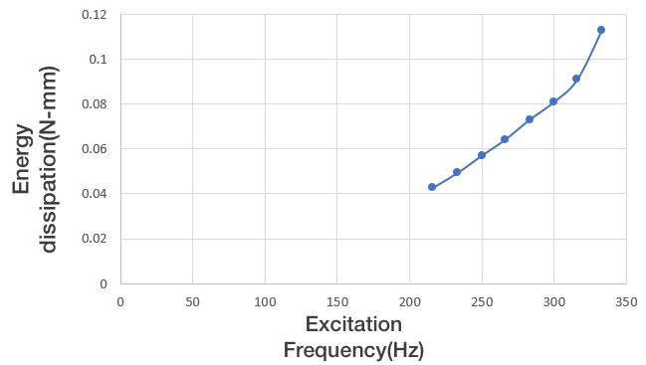
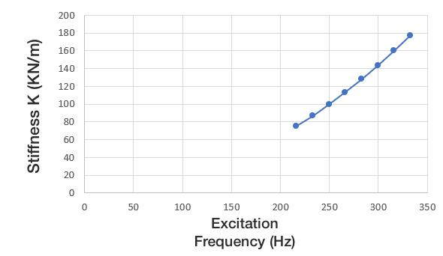

Slide 30
Conclusions
Converging film formation and Pressure distribution is governed by Reynolds Equation.
In the current project the Finite Difference Method is used to solve the Reynolds Equation
From the graph we obtained the pressure profile which is later used to find the Energy dissipation.
Pressure profile obtained for with bumps is more than with out bumps.
Reynolds equation for with and without placing the bumps is calculated and analysed using normalization and FDM and the corresponding graphs are obtained. From the above two cases the pressure distribution is analysed and we obtain a result of highest pressure in the case where the bump is placed. Energy dissipation is also calculated for the above two cases and the respective graphs are obtained. This infers that by placing the bumps the load carrying capacity and damping is increased thereby achieving the controlled vibrations.
The complexity of tribological phenomena is so large that without the use of computer technology it is difficult to make any research in this area. Computer technology that uses advanced numerical methods is a supportive tool, in many cases it allows to carry out modelling and simulation of complex tribological occurrence which take place in different nodes and different working conditions.

Slide 31
Reference
Campbell, W.E. (1969). “Boundary Lubrication: An Appraisal of World Literature.” ASME.
Shims Robert Hoffmann1 Tomasz Pronobis1 Robert Liebich SIRM 2015 – 11th International Conference on Vibrations in Rotating Machines, Magdeburg, Deutschland, 23. – 25. February 2015 A numerical performance analysis of a gas foil bearing including structural modifications by applying metal
P. N. Nagare Department of Mechanical Engineering, Amrutvahini College of Engineering Sangamner, India
A Comparative Study on Numerical Solution of Reynolds Equation of Journal Bearing
Malcolm E. Leader, P.E Co. Durango, Colorado, Applied Machinery Dynamics Understanding Journal Bearings
L. P. Alford, McGraw Hill, The American Machinist, 1911 Bearings and Their Lubrication
Wiesław Graboń, Jan Smykla, Computer program for simulation of pressure distribution in the hydrodynamic radial bearing
D. Sfyris a, A. Chasalevris b, University of Aegean, Aegean 81400, Greece
An exact analytical solution of the Reynolds equation for the finite journal bearing lubrication
https://www.tandfonline.com/doi/abs/10.1080/10402004.2010.538490

